Slide 1
Misc Topics in Vision and CNNs
Instructor: Mohammad Hasan
Office: 13-240
10/28/26
Notes:
Welcome and Introductions

Slide 2
Overview
The Adam Optimizer
ResNet
Adversarial Attacks
Tangent: time-series signals

Slide 3
ADAM
Notes:
Welcome and Introductions

Slide 4
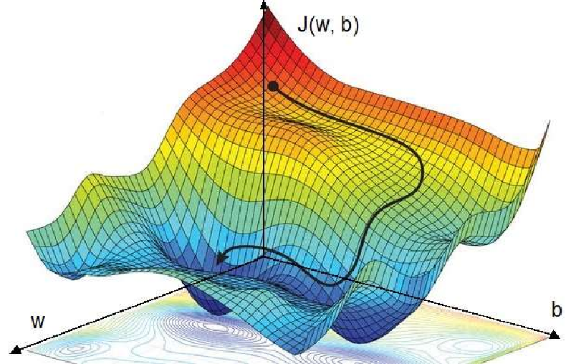
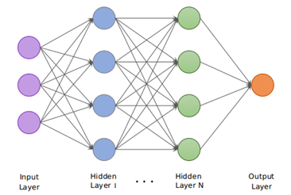
Optimization of NNs
Training a neural network (no matter the type) requires minimization of a cost/loss function
Based on weights and biases, the loss value changes.
We want to reach the absolute minimum loss.

Slide 5
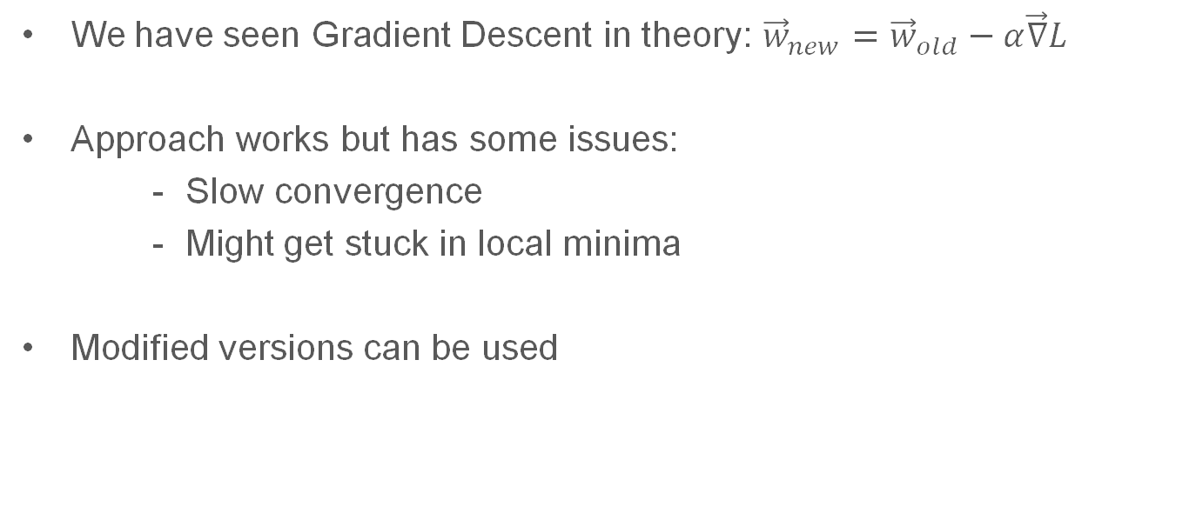
Optimization in NN
We have seen Gradient Descent in theory: ${\vec{w}}_{new}={\vec{w}}_{old}−α\vec{∇}L$
Approach works but has some issues:
    Slow convergence
    Might get stuck in local minima
Modified versions can be used

Slide 6

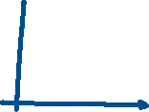




Adaptive Moment Estimation (Adam)
Uses the concept of momentum and adaptive learning rate to help increase convergence, increase training stability and move us to a more global minimum!

Slide 7







Adaptive Moment Estimation (Adam)

Slide 8
Adaptive Moment Estimation (Adam)

Slide 9
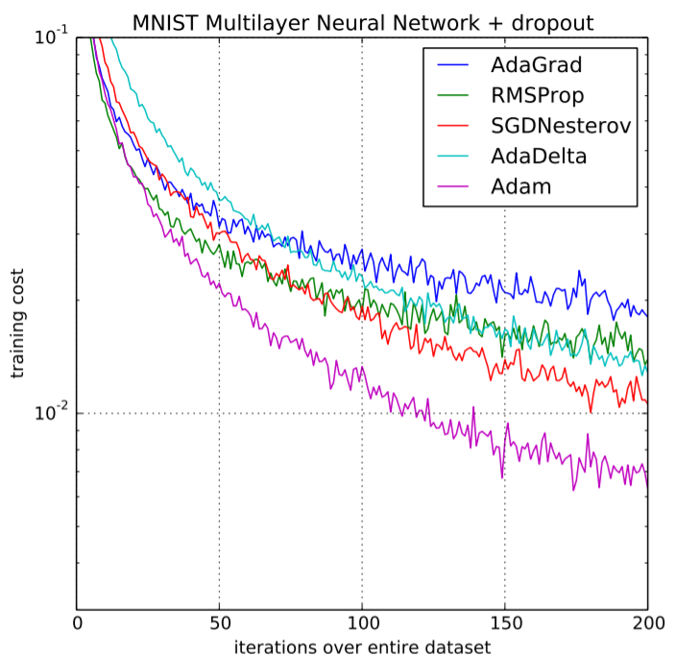
Adam Optimizer
The Adam optimizer is incredibly common.
It is built into most NN toolboxes.
Simple and produces great results

Slide 10
Deep Neural Networks and ResNet
Notes:
Welcome and Introductions

Slide 11
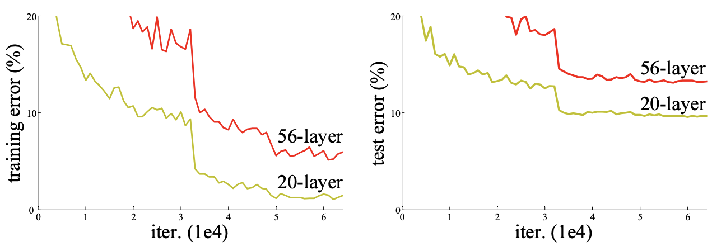
Residual Networks (ResNet)
Deep neural networks are good at processing information.
We expect that, the deeper the neural network, the better the result.
Shockingly, this may not be always the case:

Slide 12
Residual Networks (ResNet)
In vision applications, sometimes, deeper neural networks are worse?!
This caused a bottleneck in the performance of CNNs.
But why?

Slide 13



Deep Neural Networks

Slide 14
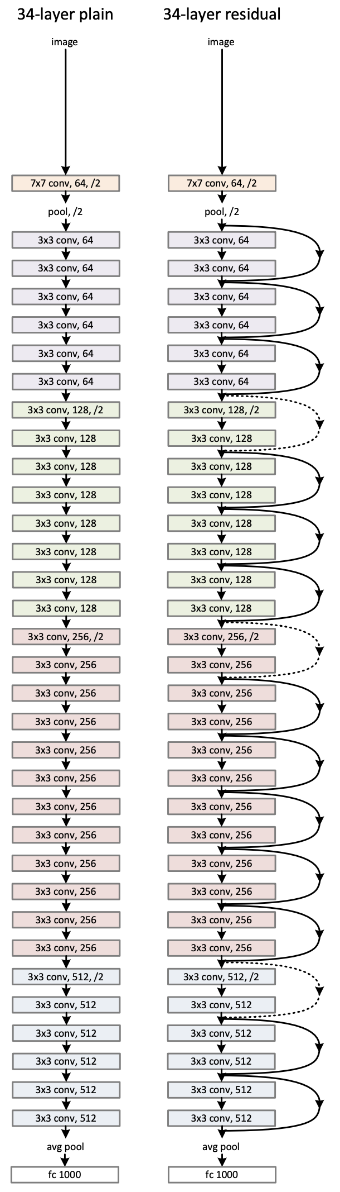
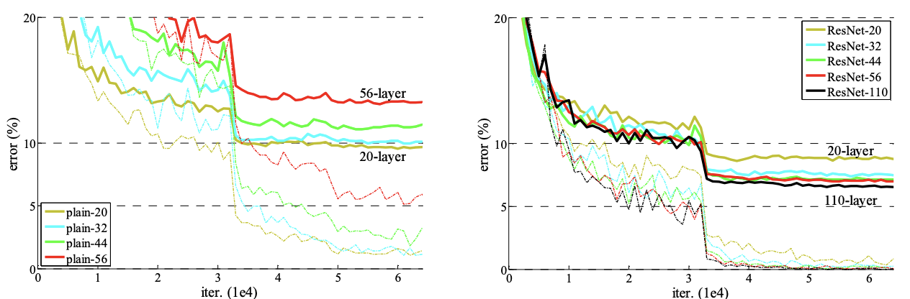
Breakthrough? Passthrough!
A breakthrough in NNs was made by using Residual Networks (ResNet).
Allows some information to flow through the network (see the right image).
ResNet allow for far deeper neural networks!

Slide 15





ResNet

Slide 16
Residual Networks are very common
In a GPT:
Residual Stream
Residual architecture

Slide 17
Adversarial Attacks on Neural Networks
Notes:
Welcome and Introductions

Slide 18
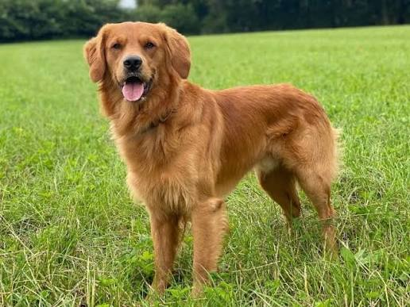
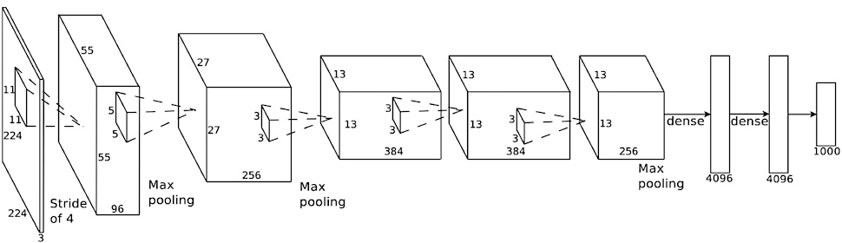
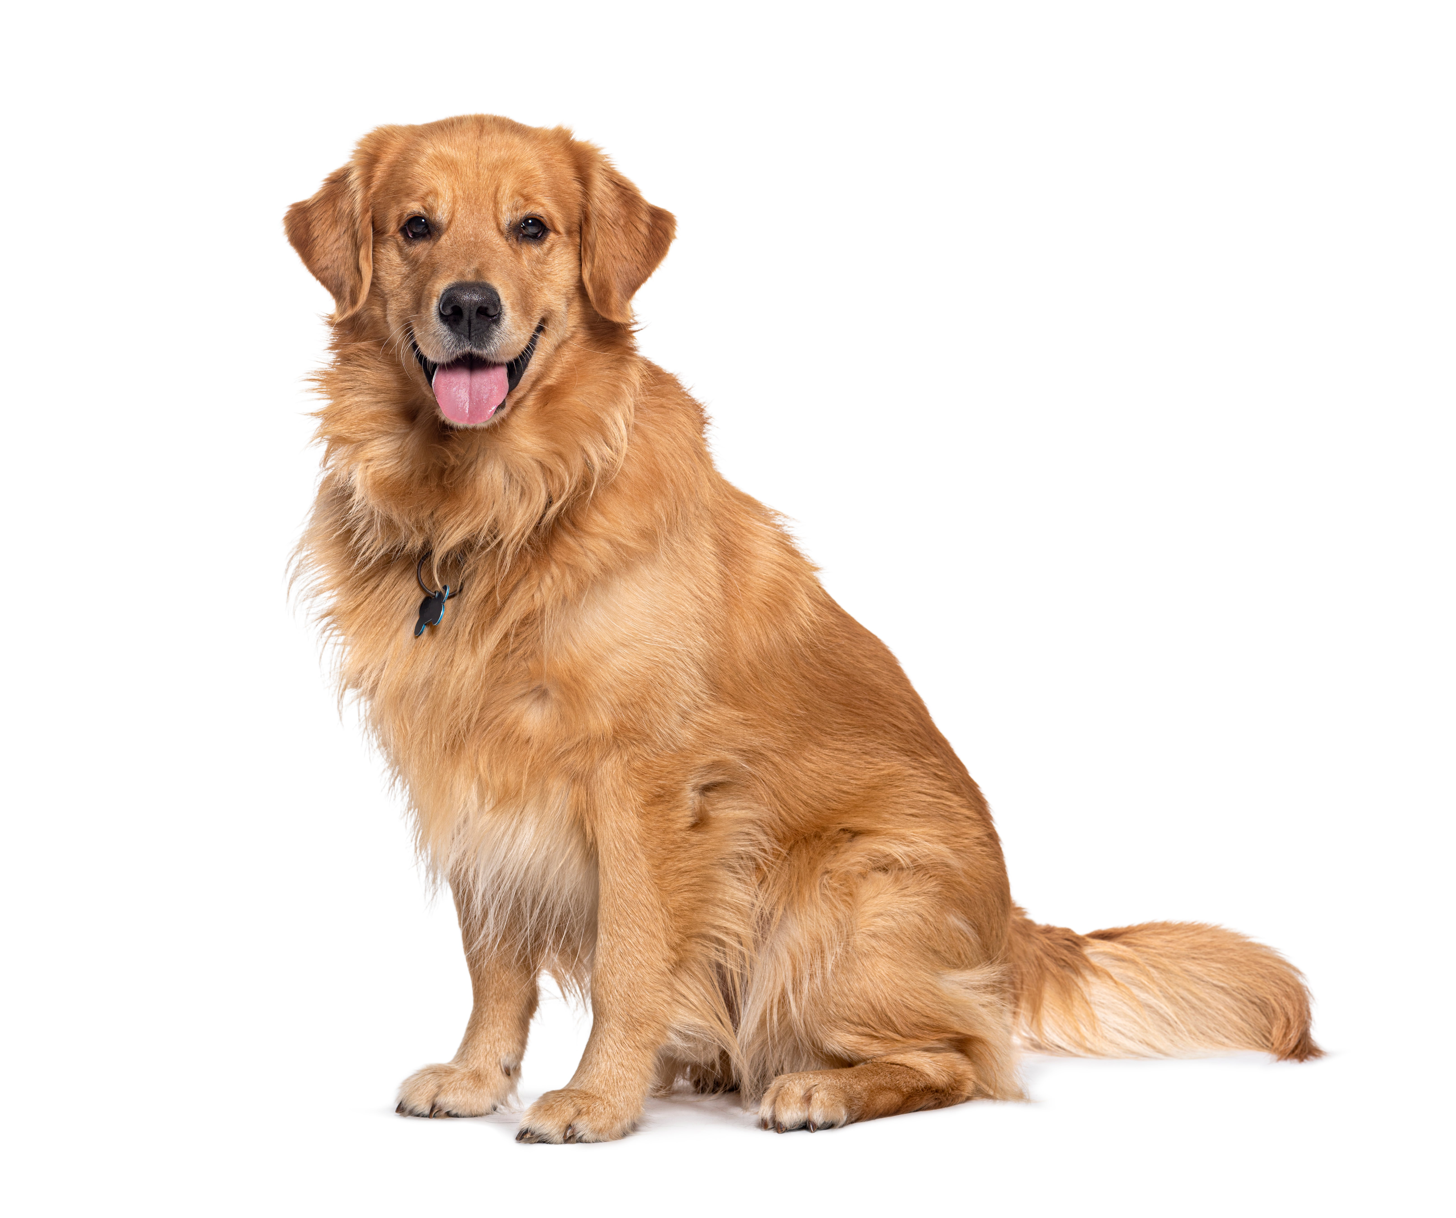
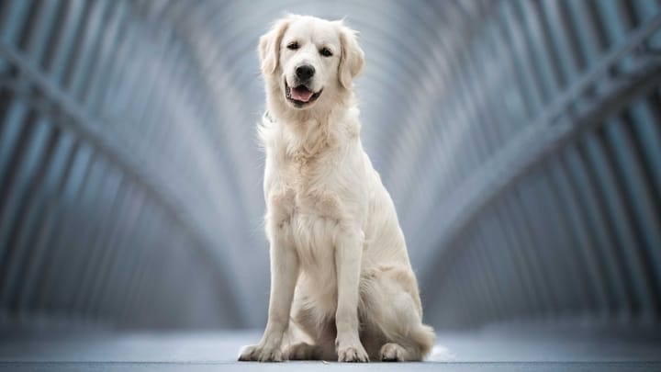
Vision Systems
We expect our neural networks to generalize.
If performance on training and validation sets yield good results, we expect similar data to be analyzed just as well.
Golden Retriever
Golden Retriever
Golden Retriever

Slide 19

What We Hope
Convolutional Neural Networks to be robust.
We want to be able to pick up useful features from images for generalization.
Golden Retriever
…
Detect animal
Detect edges
Detect shapes

Slide 20
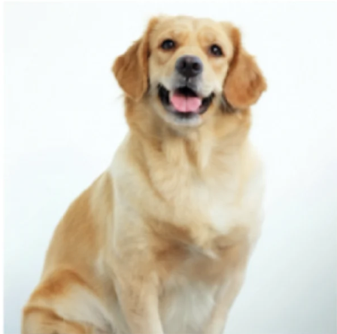

Adversarial Attacks
Sometimes, the black box nature of NNs can be used to exploit them
Output 1:
Golden Retriever
Output 3:
Digital Clock

Slide 21
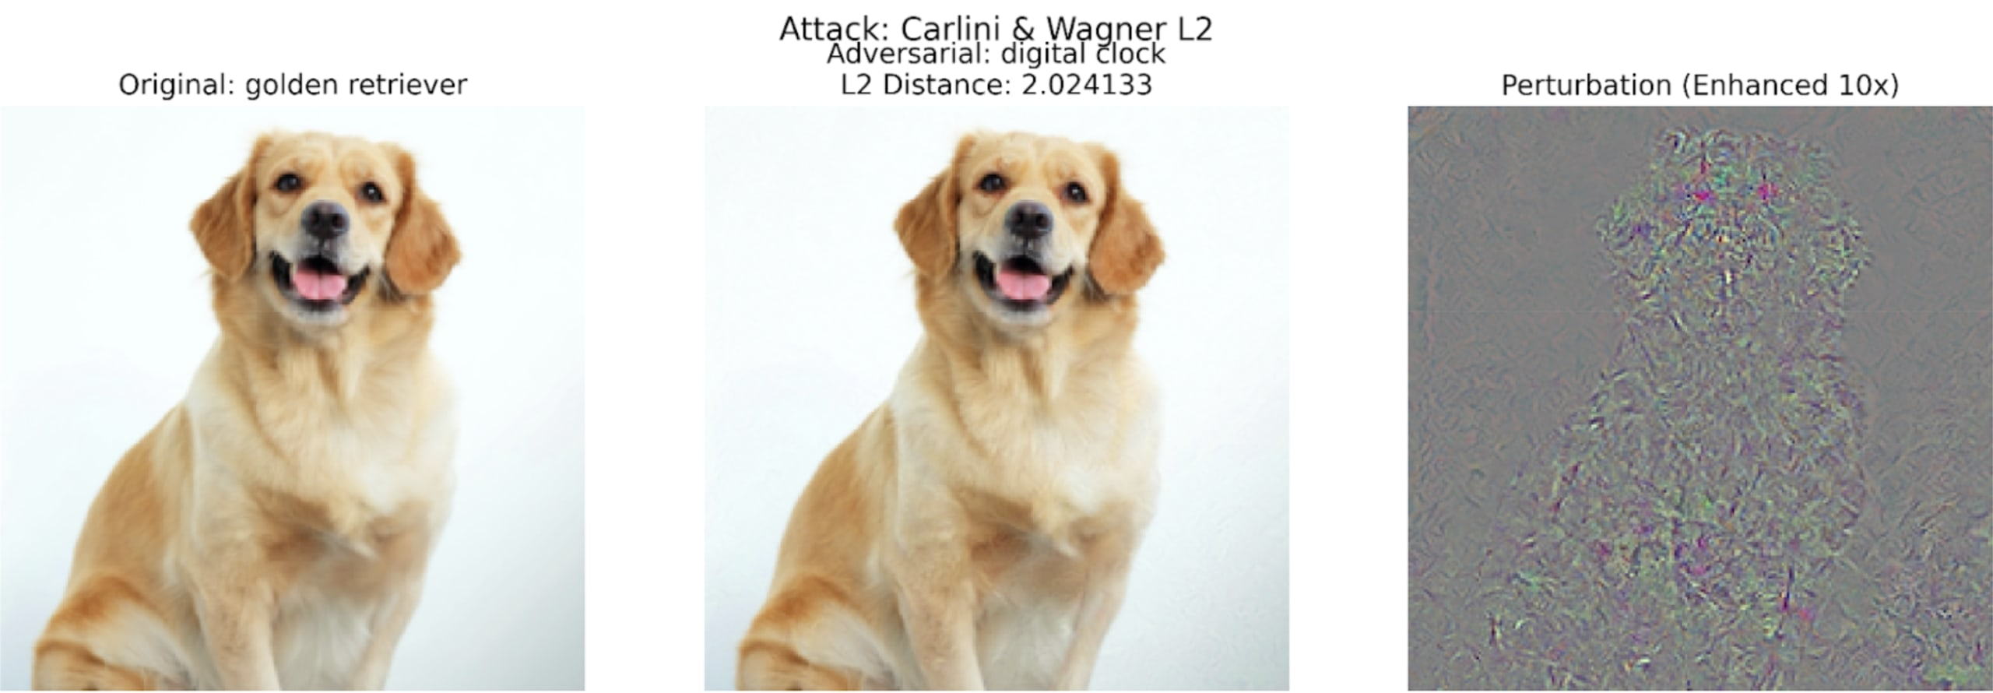
Adversarial Attacks
Injecting a specific signal can trick the NN
In real life examples, reliability needs to be guaranteed!

Slide 22
Solutions
Design threat model
Certified robustness
Use robust training algorithms
Detect-and-abstain
Preprocessing and de-noising

Slide 23
Time Series Analysis
Notes:
Welcome and Introductions

Slide 24
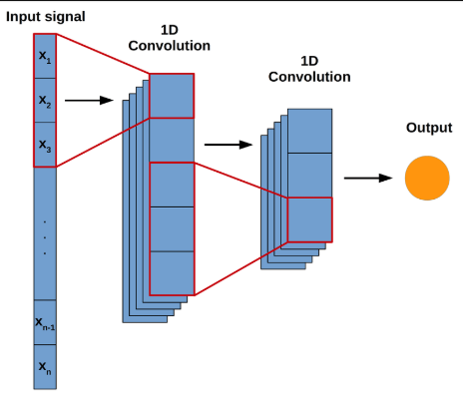
Time Series Analysis
Some signals can only be understood when studied for a period of time (ex: EKG signals, human activity signals).
CNNs can be used to deal with these signals.
How: Using a sliding window and 1D convolution kernels.

Slide 25
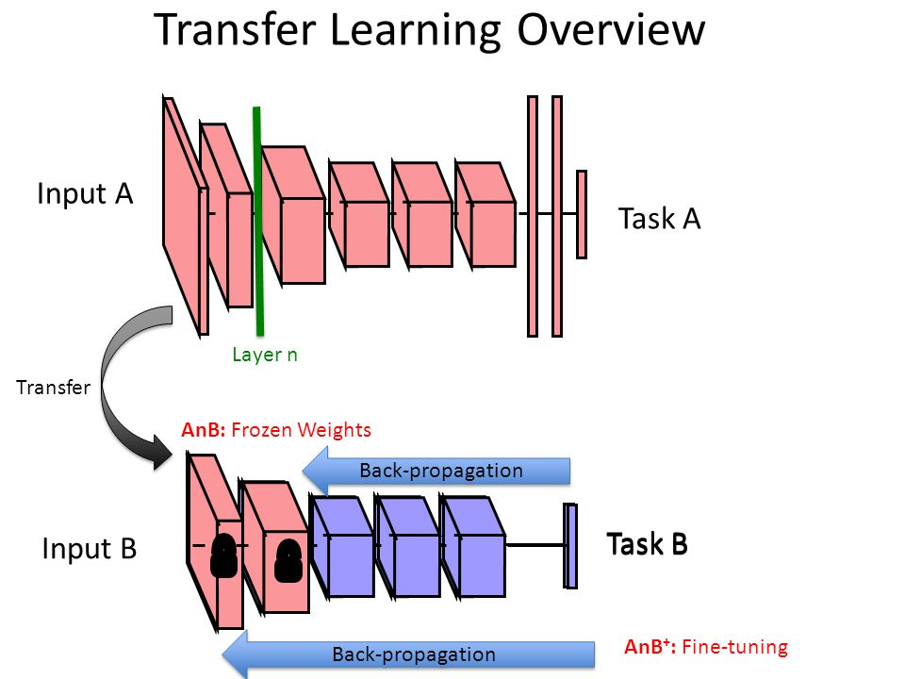
Transfer Learning (TL)
Allows the use of pre-trained neural networks for new tasks.
Often requires changing a part of the original network (like the output layer).
Options: Train the new part and freeze the rest or train everything.
The closer the original task to the new one, the easier transfer learning.

Slide 26
References
He, K., Zhang, X., Ren, S., & Sun, J. (2016). Deep residual learning for image recognition. In Proceedings of the IEEE conference on computer vision and pattern recognition (pp. 770-778).
Adam optimizer: https://www.geeksforgeeks.org/deep-learning/adam-optimizer/
https://docs.pytorch.org/docs/2.14/generated/torch.optim.Adam.html

Slide 27
Extra notes

